Slide 1
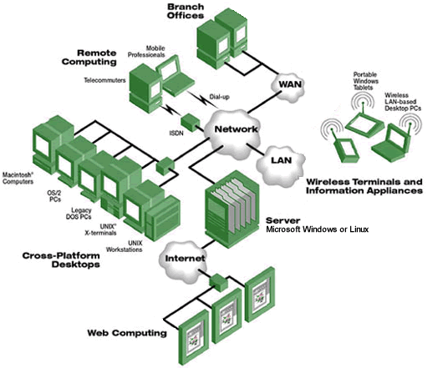

Network Forensics
Notes:
In this lecture, we will study another important topic in digital forensics, network forensics. As the name indicates, we will study digital forensics from computer network perspective.

Slide 2



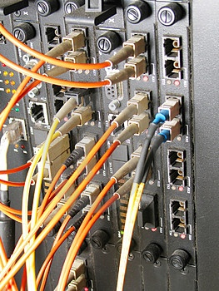

Dose of Reality:
We are Connected
Notes:
We are living a wonderful, connected world. So we can do many things, such as meeting and video conferencing your friends online, working together with remote collaboration.
[click]
What if someone cuts your network cable? How would you feel if it happens?
[click]
You don’t like it, for sure.

Slide 3



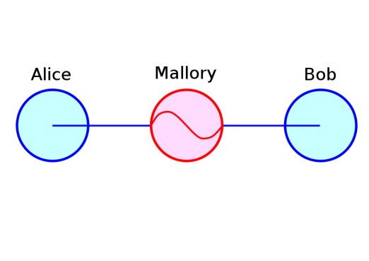




Dose of Reality: (cont’d)
We Are Not Safe!
Hacker
Eavesdropping
DoS attacks
Impersonation
Internet
MITM attacks
Modification
phishing
Notes:
While it is great to go online, but we are not safe when online. For example, we could be DoS attacked, our messages transmitted over the Internet could be intercepted, somebody else could impersonate us. Today’s online world is not safe.

Slide 4

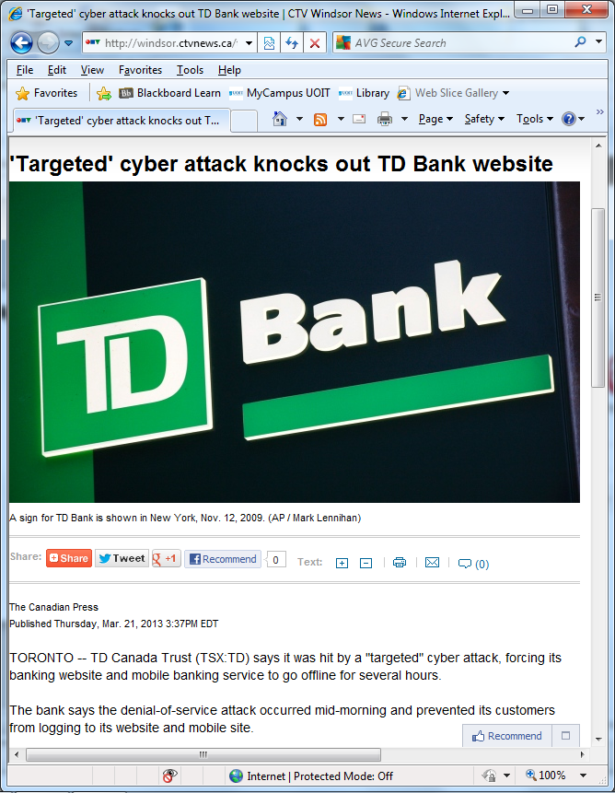
Dose of Reality: (cont’d)
Notes:
Next, let us take a look at a real cyberattack incident happened in Canada. In 2013, a "targeted" cyber attack forced TD bank’s website and mobile banking service to go offline for several hours. So you know it is a big loss to the bank. As such, TD bank wants to know what happened and also wants to catch the bad guy behind it.

Slide 5


Dose of Reality: (cont’d)
On the Internet, every action leaves a mark—in routers, firewalls, web proxies, and within network traffic itself. When a hacker breaks into a bank, or an insider smuggles secrets to a competitor, evidence of the crime is always left behind.
Notes:
On the Internet, every action leaves a mark—in routers, firewalls, web proxies, and within network traffic itself. When a hacker breaks into a bank, or an insider smuggles secrets to a competitor, evidence of the crime is always left behind.

Slide 6



Notes:
But the big question is: how to catch a bad guy on the Internet?

Slide 7

Network Forensics
Network forensics is the analysis of network events, including network traffic, netflow, security device or appliance log, in order to ascertain
how an attack was carried out or
how an event occurred on a network.
Notes:
This is where network forensics comes into play. Network forensics is the analysis of network events, including network traffic, netflow, security device or appliance log, in order to ascertain 1) how an attack was carried out or 2) how an event occurred on a network.

Slide 8

Computer Network Fundamentals - Review of TCP/IP Internetworking
Notes:
Before I proceed to talk about network security, I will give a quick review on Computer Network Fundamentals and go through some networking terminology. A basic understanding of networking is important for anyone to better understand network security and defense.

Slide 9

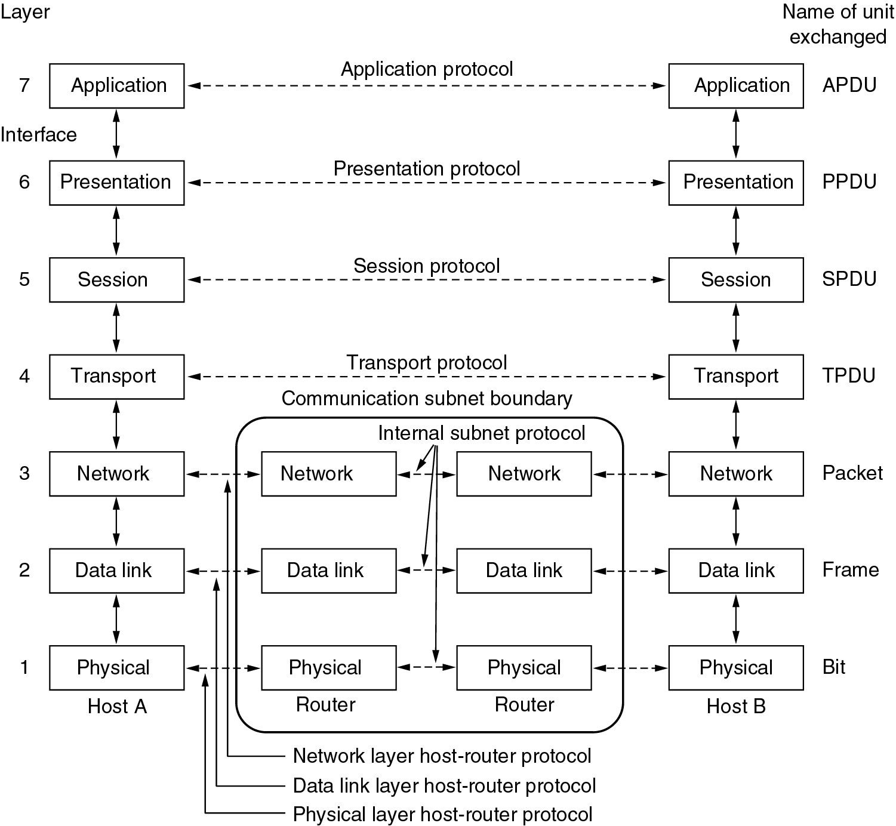
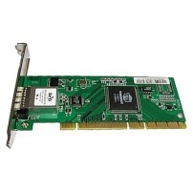
OSI (Open System Interconnection) Reference Model
Message formats and rules for exchanging those messages between computers on a network.
(e.g., HTTP)
Segment
packet
Notes:
Many network structures are based (at least loosely) on the ISO OSI 7 layer model. The functionalities of a networked computer can be divived into 7 layers, including
Physical, Data Link Layer, Network Layer, Transport Layer, Session Layer, Presentation Layer, and Application Layer.
[click]
Network protocols define message formats and rules for exchanging those messages between computers on a network, for example, HTTP defines web traffic between Web server and client.
An interface defines how data is delivered and interpreted between two adjacent layers.
Each layer defines its own protocol data unit (or PDU for short), which is a single unit of information transmitted among peer entities of a computer network, usually named in its layer name followed by
PDU. For example, the data unit at the Application layer is called APDU.
[click]
For some layers of the OSI model, PDUs at these layers have special terms, for example,
In Layer 3 (network layer), PDU is a packet.
Also, In Layer 1, PDU is a bit, in Layer 2 it is a frame, and in Layer 4 it is a segment.
[Click]
In order to have a computer connected to the Network, it must have a Network Card (aka Network Interface Card or network Adapter Card). It could support wired or wireless communications.

Slide 10
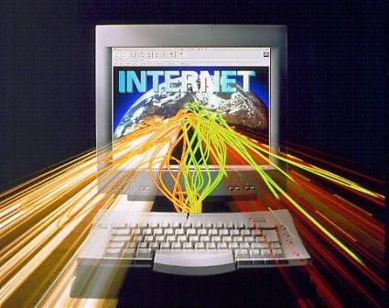
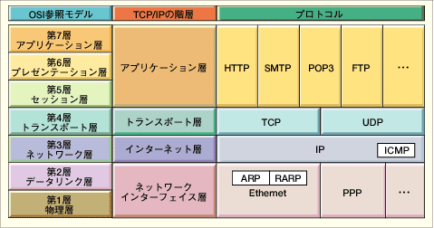

IETF Reference Model (TCP/IP model)
OSI Model
TCP/IP Hierarchy
Protocols
7th
Application Layer
6th
Presentation Layer
Application Layer
5th
Session Layer
4th
Transport Layer
Transport Layer
3rd
Network Layer
Network Layer
2nd
Link Layer
Link Layer
1st
Physical Layer
Physical Layer
Notes:
The networking model used by the Internet is The TCP/IP model, is another layering model that is simpler.
It defines the five separate layers, some of which overlap with the OSI model

Slide 11
Data Encapsulation & Decapsulation in the OSI and TCP/IP Models
Notes:
A good understanding of some networking concepts is important for you to understand how computer networking works.
So we will briefly review data encapsulation and data decapsulation.
In a layering networking model, including the OSI model and TCP/IP model, data flows 2 ways, DOWN (data encapsulation) and UP (data decapsulation).
Next, I will use TCP/IP model as an example to illustrate how data encapsulation and data decapsulation work.

Slide 12

Layer Cooperation Through Encapsulation on the Source Host
Lower layers add headers (and sometimes trailers) to upper layers packets
Application
Data
TCP Header
Data
Transport
IP Header
Transport Packet
Network
IP Header
TCP Header
Data
MAC Header
Network Packet
Trailer
Data Link
MAC Header
IP Header
TCP Header
Data
Trailer
Network media
Notes:
Suppose a computer (which is source) needs to send some data to another computer (which is destination). The Application layer is where the user interface exists, here the user interacts with the application he or she is using, then this data is passed to the Transport layer and then to the Network layer and then to the Data Link layer.
When a data is moving down, some extra information will be added in the front (called header), and sometimes some information added in the end (trailer).
For example, the Network layer adds its IP header (including source and destination IP addresses) and then sends it off to the Datalink layer.
The data at the Datalink layer, called a frame, is really a logical group of 1's and 0's, the Physical layer is responsible for transmitting these digits to another computer on the same local network.
The process is called data encapsulation, which occurs when data is sent.

Slide 13
Layer Cooperation Through Decapsulation on the Destination
Upper layers peel headers (and sometimes trailers) off lower layers packets
Application
Data
TCP Header
Data
Transport
IP Header
Transport Packet
Network
IP Header
TCP Header
Data
MAC Header
Network Packet
Trailer
Data Link
MAC Header
IP Header
TCP Header
Data
Trailer
Network media
Notes:
Suppose the data is received at the destination computer, Also, we assume it receives the whole frame.
Then, the received frame will be passed to the layer above it.
Header and/or trailer will be removed and stripped off as a data is moving up.
The process is called data decapsulation, which occurs when data is received.

Slide 14

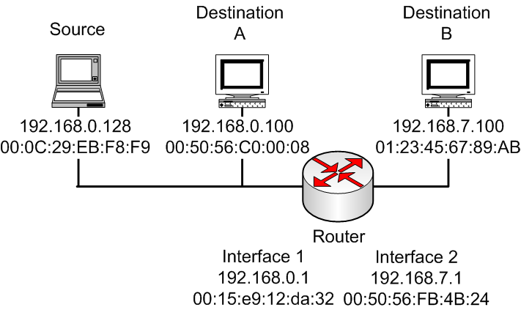
TCP/IP Networking An Example
S
Notes:
Next, I will use two simple examples to illustrate how TCP/IP networking works.
Assume we have three computers, one is source, and two destinations, Destination A is located in the same the same network segment as the source, whereas Destination B is located in the different network segment. Two network segments are connected to each other through a router.

Slide 15

S
Source S creates IP packet with source S, destination A
S uses ARP to get A’s physical layer address for 192.168.0.100
S creates Ethernet frame with A's physical address as dest, Ethernet frame contains S-to-A IP datagram
S’s data link layer sends Ethernet frame
A’s data link layer receives Ethernet frame
A removes IP datagram from Ethernet frame, sees it’s destined to itself
Encapsulation
Decapsulation
Notes:
First, we talk a look at the scenario where the source communicates to Destination A.

Slide 16
S
Source S creates IP packet with source S, destination B
S uses ARP to get R’s physical layer address for 192.168.0.1
S creates Ethernet frame with R's physical address as dest, Ethernet frame contains S-to-B IP datagram
S’s data link layer sends Ethernet frame
R’s data link layer receives Ethernet frame
R removes IP datagram from Ethernet frame, sees it’s destined to B
Encapsulation
Decapsulation
Notes:
Next, we talk a look at the scenario where the source communicates to Destination B.
Remember that Destination B is located in the different network segment.

Slide 17

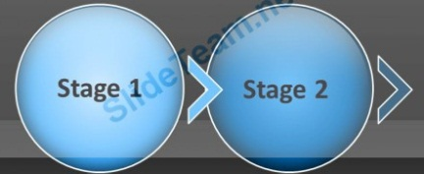
S
Encapsulation
R uses ARP to get B’s physical layer address
R creates frame with B's physical address as dest, and Ethernet frame contains S-to-B IP datagram
R’s data link layer sends Ethernet frame
B’s data link layer receives Ethernet frame
B removes IP datagram from Ethernet frame, sees it’s destined to itself
Decapsulation

Slide 18


Internet is a Network of Networks
Network
Notes:
The global Internet has thousands of networks, and Internet is a Network of Networks.
TCP/IP for packet routing and connections
Border Gateway Protocol (BGP) for route discovery
Domain Name System (DNS) for IP address discovery

Slide 19

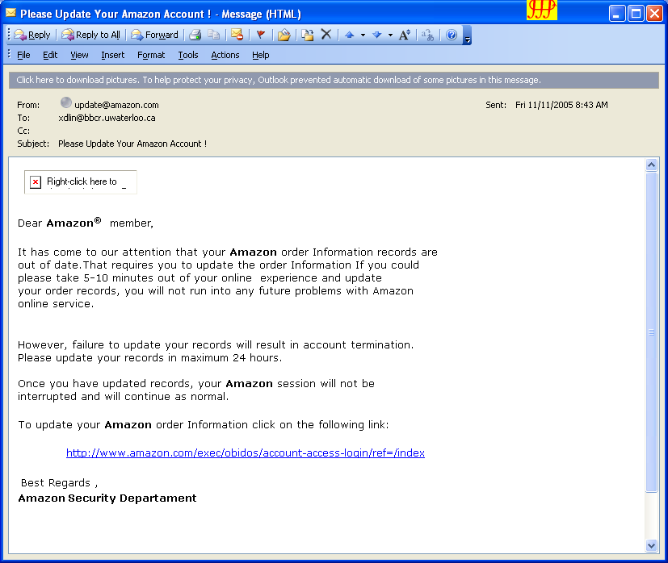
http://203.130.234.141/icons/register/login/index.html
Notes:
Next, let’s take a look at how we can use computer network technique to investigate some cyber attack.
I believe every day you have been receiving dozens of phishing emails and spam emails, asking you to go to a fraudulent or spoofed website to
enter your sensitive information (e.g., your credit card number or your password).
It’s a scheme to capture your sensitive information. It is very frustrating.
Therefore, you don't want to fall into the trap.
For example, receiving an email like this might be a cause for concern:
it claims from Amazon, asking me to update my order information. It provides a link, saying the Amazon website
[click]
However, if you hover over the URL and check the link, pointing to a strange IP address, 203.130.234.141.

Slide 20
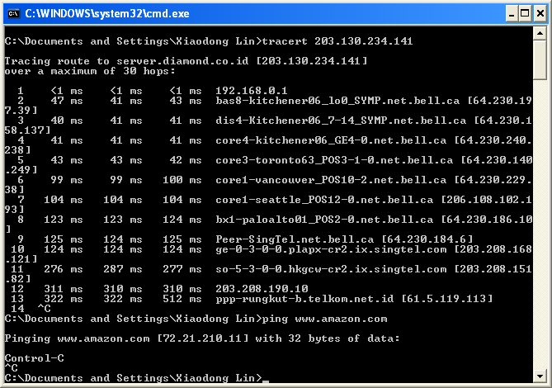
Indonesia
Notes:
So you can use some network tool, for example, tracert to check the route to the IP address.
It tells it has a different domain name. From its domain name, you find out that the IP address is located in Indonesia.
Based on this, you will immediately see it suspicious since we know Amazon is headquartered in US.
[click]
Also, you can further check the IP address of Amazon website by pinging it. So you can see the actual IP address is different from the one embedded in the email.
[click]
So you can conclude it is a phishing email.

Slide 21
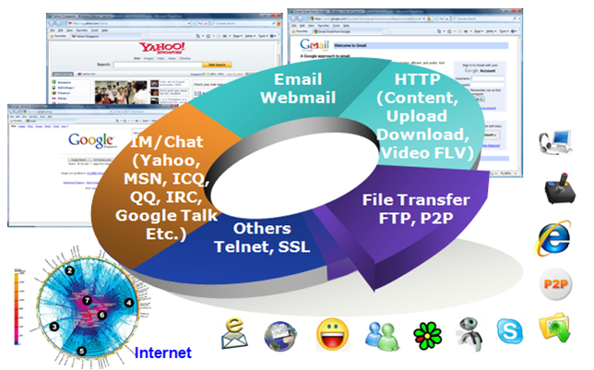
Network Forensics
Notes:
So let us take a look at network forensics in more detail

Slide 22

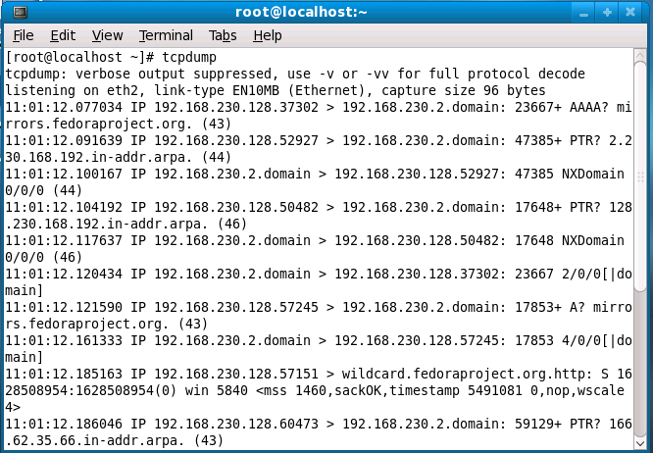
Data collection - Capture Network Traffic
1
Notes:
Similar to any forensic investigation, we will first need to collect data. In network forensics, we need to capture network traffic.

Slide 23
Data types:
Raw network traffic data
Netflow traffic data
Notes:
There are two types of network traffic: Raw network traffic data and Netflow traffic data.

Slide 24


Capture Raw Network Traffic
In Today’s Network Environments
Notes:
We will first look at how to capture raw network traffic.
So it is easy that we simply plug into any network port to collect network traffic. Is it right?
[click]
Actually, it is not that easy and straightforward in today’s network environments.

Slide 25
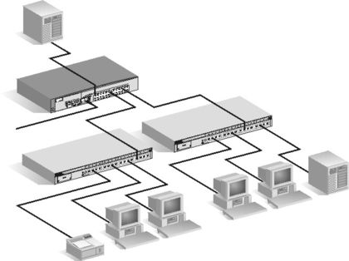
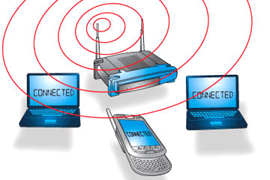
Dose of Reality:
Wireless Network
Wired Network
Notes:
Next, we will study why it could be challenging to capture raw network traffic in today’s network environments.
Before we proceed, we will look at today’s network environments.
There are two main types of network, wireless network and wired network.

Slide 26

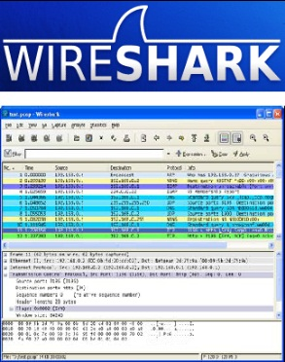



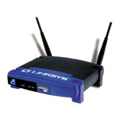
Dose of Reality: (cont’d)
Wireless Network
Network Sniffing
[1] http://www.wireshark.org/download.html
[2] airsnort. http://airsnort.shmoo.com/
[3] aircrack-ng. http://www.aircrack-ng.org/doku.php
Notes:
For wireless network, as far as you put your wireless network sniffers within the transmission range of the computers and wi-fi routers,
you are able to capture data on wireless networks.

Slide 27

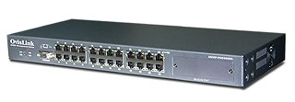
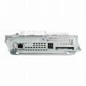
Dose of Reality: (cont’d)
Wired Network
hub
switch
Network Sniffing
Notes:
Next, we take a look at wired network. The situation becomes very challenging.
This is because today’s network is switched network where the computers are connected by network switches rather than hubs in old days.
With a regular switch the network traffic is visible only to computers, which directly participate in a communication. Other computers do not see the traffic, that is not destined for them.
The switch only forwards the network traffic to the switch port connecting the computer that network traffic is destined for. If you simply connect your network sensor to another switch port, it will not see the traffic between two communicating computers.
This is different from a network hub in which all the network traffic will be broadcast to all the ports.

Slide 28
Sniffing on a Hub
Notes:
I would like emphasize the fact that it is indeed very easy to sniff on a hub since hub is a networking but broadcasting device, which broadcasts all network data across each hub port. However, it is not used very often today.

Slide 29
Switch Sniffing
No traffic
Network Sniffing
Notes:
However, it becomes very challenging to sniff on a switch.
The switch only forwards the network traffic to the switch port connecting the computer that network traffic is destined for.
[click]
If you simply connect your network sensor to another switch port, it will not see the traffic between two communicating computers.

Slide 30
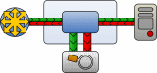
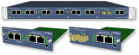

Switch Sniffing (cont’d)
Three different network data collection techniques
SPAN/Mirror port at managed switch
TAP(Test Access Port)^{[1]}
ARP spoofing
[1] http://www.networkcritical.com/
Notes:
Typically, there are three popular approaches to do switch sniffing.

Slide 31
Sensor Deployment - Switch Sniffing (cont’d)
SPAN/Mirror port at managed switch
Port mirroring (SPAN (Switch Port Analyzer)) — the switch sends a copy of network packets to the SPAN/Mirror port.
Performance?
[1] Using a Managed Switch as a Network "Tap". http://www.intermapper.com/resources/blogs/rich-brown/524-using-a-managed-switch-as-a-network-qtapq
[2] Network switch. http://en.wikipedia.org/wiki/Network_switch
Notes:
First, you can configure a network switch port to SPAN/Mirror port. It is called Port mirroring (SPAN (Switch Port Analyzer)). When port mirroring enabled, the switch sends a copy of all network packets seen on one port to the SPAN/Mirror port or a monitoring network connection, where the packet can be analyzed.

Slide 32

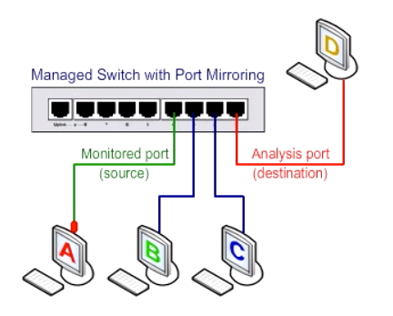
Sensor Deployment - Switch Sniffing (cont’d)
[1] Network switch. http://en.wikipedia.org/wiki/Network_switch
Notes:
Let’s take a look at a simple example. Suppose computers A and B are communicating to each other. So by default, computers C and D will not see the network traffic sent between computers A and B.
If we configure the network switch port where Computer D connects to as SPAN/Mirror port, for example,
mirroring to computer D all network packets, which are transmitted between computers A and B.
Then, Computer D is able to see all the network traffic sent between computers A and B.
So port mirroing allows a particular computer to see the network traffic, which is normally hidden from it.

Slide 33
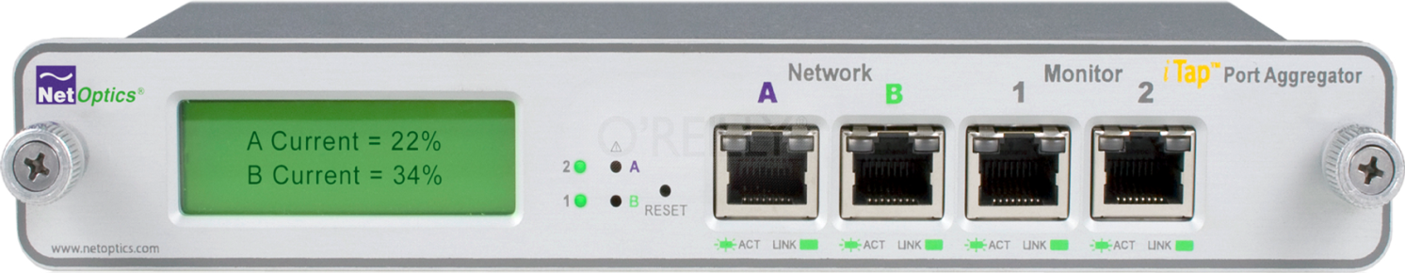
Switch Sniffing (cont’d)
TAP (Test Access Port), aka network tap
A network tap is a hardware device which provides a way to access the data flowing across a computer network. The network tap has at least three ports -- an “A” port, a “B” port, and a monitor port.
[1] Network tap. http://en.wikipedia.org/wiki/Network_tap
Notes:
Second, we need a special hardware, TAP (Test Access Port), aka network tap
A network tap is a hardware device which provides a way to access the data flowing across a computer network. The network tap has at least three ports -- an “A” port, a “B” port, and a monitor port.

Slide 34
Switch Sniffing (cont’d)
Monitoring port
b
expensive
TAP
a
Notes:
So when you connect your computer to the switch, instead of connecting the computer to the switch directly, you will need to first connect your computer to either port A or port B. Then, connect another port to the switch.
In order to monitor or capture network traffic, you will need to connect network sniffer to the monitoring port of TAP.
One big disadvantage for TAP is the cost. TAP is very expensive.

Slide 35
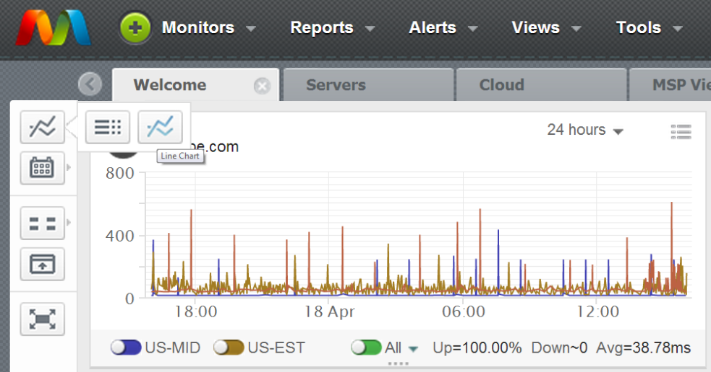
Switch Sniffing (cont’d)
To place a tap between network points a and b, the network cable between point a and point b is replaced with a pair of cables, one going to the tap's “A” port, one going to the tap's “B” port. The tap passes through all traffic between “A” and “B”, so a and b still think they are connected to each other, but the tap also copies the traffic between “A” and “B” to its monitor port, enabling a third party to listen.
[1] Network tap. http://en.wikipedia.org/wiki/Network_tap
Notes:
This is what happened during the deployment of TAP.

Slide 36
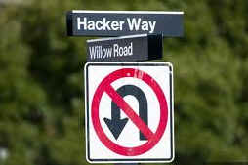
Switch Sniffing (cont’d)
ARP Spoofing
Notes:
Another approach for switch sniffing is using hacker way. Particularly, we can use ARP spoofing attack to sniff the network traffic in a switch.

Slide 37





ARP: address resolution protocol
Question: how to determine
interface’s MAC address, knowing its IP address?
ARP table: each IP node (host, router) on LAN has table
IP/MAC address mappings for some LAN nodes:
< IP address; MAC address; TTL>
TTL (Time To Live): time after which address mapping will be forgotten (typically 20 min)
137.196.7.78
1A-2F-BB-76-09-AD
137.196.7.23
137.196.7.14
LAN
71-65-F7-2B-08-53
58-23-D7-FA-20-B0
0C-C4-11-6F-E3-98
137.196.7.88
Notes:
Next, let’s first recap address resolution protocol. Each adapter on LAN has unique IP address and LAN (or MAC) address. For network communication, we know we need to use IP address. But we need to use MAC address in LAN.
But how to determine the MAC address of a computer, knowing its IP address?
Now we talk about ARP or address resolution protocol. It maintains an ARP able in a computer, containing IP/MAC address mappings for some LAN nodes. If a computer’s MAC is not found in the table, ARP protocol will be executed.

Slide 38
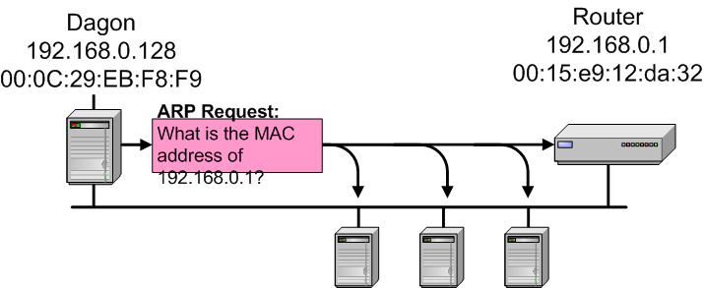
How ARP works?
ARP request broadcast on Ethernet
Destination host ARP layer responds
A
broadcast message
ARP Reply:
The MAC address of 192.168.0.1
is 00:15:e9:12:da:32.
B
Notes:
How ARP works?
Suppose A wants to send datagram to B (but B’s MAC address not in A’s ARP table)
A broadcasts ARP query packet, containing B's IP address, destination MAC address = FF-FF-FF-FF-FF-FF
So all nodes on LAN receive ARP query
B receives ARP packet, replies to A with its (B's) MAC address frame sent to A’s MAC address (unicast)
A caches (saves) IP-to-MAC address pair in its ARP table until information becomes old (times out)

Slide 39
Switch Sniffing (cont’d)
Normal switched networks
Switches relay traffic between two stations based on MAC addresses
Stations only see broadcast or multicast traffic
Address Resolution Protocol (ARP) spoofing
Attacker spoofs destination and source physical addresses
Forces all traffic between two stations through its system, i.e., Address Resolution Protocol (ARP) spoofing, also known as ARP poisoning or ARP Poison Routing (APR).
Notes:
Switches relay traffic between two stations based on MAC addresses. Stations only see broadcast or multicast traffic.
Unfortunately, attackers can spoof destination and source MAC addresses,
forcing all traffic between two stations (destination and source) through its system, i.e., Address Resolution Protocol (ARP) spoofing, also known as ARP poisoning or ARP Poison Routing (APR).

Slide 40

Real ARP Reply
Broadcast ARP Request
Notes:
For example, when Client (C) wants to send datagram to Server (S), C broadcasts ARP query packet, containing S's IP address destination and MAC address = FF-FF-FF-FF-FF-FF. So all nodes on LAN receive ARP query, and server S receives ARP query packet, and replies to client C with its (S's) MAC address.
But, the attacker also receive ARP query, and can also reply to client C with a fake MAC address for the server.
If the spoofed ARP reply arrives earlier than the real one, the client thinks the fake MAC address is the one for the server. So the client is under ARP spoofing attack.
Similarly, the server can be also attacked.

Slide 41
Host to Host Exploit
Real ARP Reply
Broadcast ARP Request
Notes:
There are mainly two types of ARP spoofing scenarios:
The first one is Host to Host Exploit, which is the scenario we discussed in the previous slide. Particularly, when a computer (e.g., Client (C)) wants to send datagram to another computer (e.g., Server (S)), C broadcasts ARP query packet, containing S's IP address destination and MAC address = FF-FF-FF-FF-FF-FF. Note that all 1 MAC address means broadcast address. So all nodes on LAN receive ARP query, and server S receives ARP query packet, and replies to client C with its (S's) MAC address.
But, the attacker also receive ARP query, and can also reply to client C with a fake MAC address for the server, making the client believe that the fake MAC address belongs to the server. But it is not true.

Slide 42
Host to Router Exploit
Real ARP Reply
Broadcast ARP Request
Notes:
The second one is Host to Router Exploit, which is the scenario where the attacker spoofs the MAC address of a router to all the computers in the local network connecting to the router.
For example, when a computer (e.g., Client (C)) wants to send datagram to a remote computer on the Internet. As such, C needs to communicate to the router R, which will help to forward the datagram to another network. So C needs to know the MAC address of the router R’s interface connecting to the local network where C is located in.
C broadcasts ARP query packet, containing the router R's IP address destination and MAC address = FF-FF-FF-FF-FF-FF. Note that all 1 MAC address means broadcast address. So all nodes on LAN receive ARP query, and router R receives ARP query packet, and replies to client C with its (R's) MAC address.
But, the attacker also receive ARP query, and can also reply to client C with a fake MAC address for the router, making the client believe that the fake MAC address belongs to the router. But it is not true. Afterwards, all the network traffic originating from C to the remote computer will go to the attacker first.

Slide 43

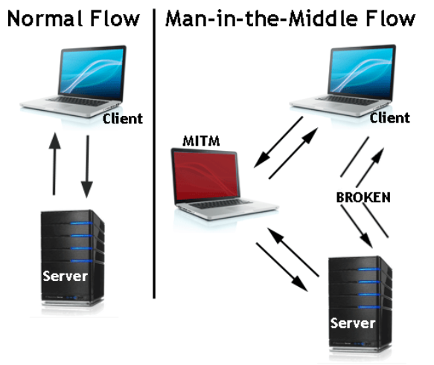
Relay Configuration
MITM
DoS
Notes:
A successful ARP spoofing (poisoning) attack allows for a man-in-the-middle attack. Specifically, the attacker is able to make Alice believe that the attacker’s MAC address belongs to Bob, and also make Bob believe that the attacker’s MAC address belongs to Alice.
There are two bad consequences.
First, Alice and Bob update their ARP tables and from that point onwards, communicate with the attacker instead of directly with each other. The attacker is now secretly in the middle of all communications. So the attacker can sniff all the traffic between Alice and Bob. In other words, Alice and Bob are under man-in-the-middle or sniffing attack.
Second, it is also possible that the attacker doesn’t replay the messages from Alice and Bob, it becomes DoS attack.

Slide 44

Relay Configuration (cont’d)
0:c:3b:1a:2f:1b – 10.1.1.2
0:c:3b:1a:7c:ef – 10.1.1.7
0:c:3b:9:4d:8 – 10.1.1.7
0:c:3b:1a:7c:ef – 10.1.1.2
0:c:3b:1a:7c:ef – 10.1.1.10
Notes:
For network forensics, we use ARP spoofing attack to sniff network traffic.

Slide 45

Using Packet Sniffer
Packet sniffers
Devices or software that monitor network traffic
Most work at layer 2 or 3 of the OSI model
Most tools follow the pcap (packet capture) format
Tools
Tcpdump
Wireshark
Snort
……
Notes:
We also need some software, particularly Packet sniffers, to capture or monitor network traffic.
There are many Packet sniffers available, for example, Tcpdump, Wireshark.

Slide 46
Raw Network Traffic or packet-level data collection
Challenging to collect on very high-speed links
Extremely high volume of raw network traffic
Encrypted network traffic
Expensive to deploy
Notes:
However, network engineers are always facing the struggle to stay ahead of monitoring the traffic on their networks.
There are some challenges with the collection of raw network traffic.
For example,
Challenging to collect on very high-speed links
Extremely high volume of raw network traffic
How to deal with encrypted network traffic
Very expensive to deploy

Slide 47
NetFlow
NetFlow is a network protocol developed by Cisco Systems to run on Cisco IOS-enabled equipment for collecting IP traffic information.
NetFlow has become an industry standard for traffic monitoring.
The NetFlow protocol itself has been superseded by Internet Protocol Flow Information eXport (IPFIX), which is based on the NetFlow Version 9 implementation. IPFIX is now an IETF protocol.
[1] Netflow. http://en.wikipedia.org/wiki/Netflow
Notes:
That is why people also look at another option: netflow data.
NetFlow is a network protocol developed by Cisco Systems to run on Cisco IOS-enabled equipment for collecting IP traffic information.
NetFlow has become an industry standard for traffic monitoring.
The NetFlow protocol itself has been superseded by Internet Protocol Flow Information eXport (IPFIX), which is based on the NetFlow Version 9 implementation. IPFIX is now an Internet Engineering Task Force (IETF) protocol.

Slide 48
NetFlow (cont’d)
A network flow has been defined in many ways. The traditional Cisco definition is to use a 7-tuple key, where a flow is defined as a unidirectional sequence of packets all sharing all of the following 7 values:
Source IP address
Destination IP address
Source port
Destination port
Layer 3 protocol type
Input logical interface (ifIndex)
IP Type of Service (TOS field), such as low delay
[1] Netflow. http://en.wikipedia.org/wiki/Netflow
Notes:
What is netflow data? A network flow has been defined in many ways. The traditional Cisco definition is to use a 7-tuple key, where a flow is defined as a unidirectional sequence of packets all sharing all of the following 7 values:
Source IP address, Destination IP address,
Source port, Destination port,
Layer 3 protocol type
Input logical interface (ifIndex)
IP Type of Service (TOS field), such as low delay
In summary, NetFlow is a summary of IP traffic that is generated by network infrastructure devices. While raw network traffic or packets are the most detailed monitoring method available., in some situations, netflow data are enough to help us achieve our goals. It just depends on what we are looking for.

Slide 49
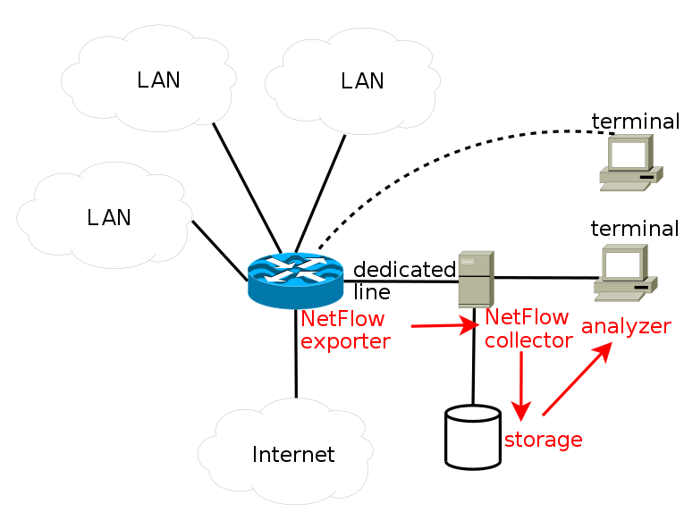
NetFlow architecture
Notes:
A typical NetFlow architecture include netflow exporter, Netflow collector and network analyzer.
A netflow exporter aggregates passing packets into flows and exports flow records towards one or more flow collectors.
Similar to syslog collector, a netflow collector is part of a netflow monitoring system designed to receive, process, and store IP traffic data packets from netflow exporters or network devices.
A netFlow analyzer is key of a netflow monitoring system designed to analyze your network bandwidth & network traffic, detecting abnormal network activities.

Slide 50
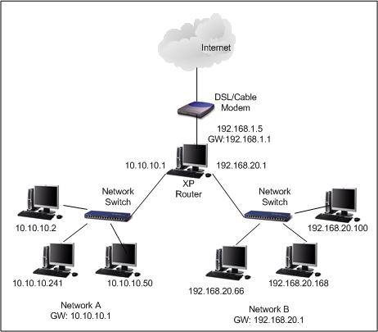
2
Network Forensic analysis techniques
View data
Acquisition
Keyword Searching
Protocol Parsing and Analysis
discover abnormality
Pattern matching
Notes:
After we collect network traffic, the next step is network analysis. For example, we can view the network data (either raw packet or netflow data), search known keywork in the network traffic, Protocol Parsing and Analysis, discovering patterns in the network data (for example, detect some DoS attacks according to some known abnormal network traffic patterns).

Slide 51
Protocol Parsing and Analysis
Too Many Protocols
Notes:
Next, we will take at how to do protocol parsing and analysis in more detail.
Unfortunately, there are too many network protocols available today.

Slide 52

Protocol Parsing and Analysis
-
Simple Mail Transfer Protocol (SMTP) and Post Office Protocol (POP3)
Notes:
I will use Simple Mail Transfer Protocol (SMTP) and Post Office Protocol (POP3) as examples.
SMTP is used to send your emails, whereas POP3 is used to retrieve and read your emails.

Slide 53

Sample SMTP interaction
Joe’s Mail Server
(TCP: 25)
Joe’s Local Host
HELO <Joe’s Mail server>
250 <Joe’s Mail server> Hello Joe, pleased to meet you
SMTP
agent
SMTP
agent
MAIL FROM:<Joe>
TCP
250 Joe... Sender ok
IP
RCPT TO:<Bob>
250 Bob... Recipient ok
Dear Bob,
Please reply. Best regards, Joe
.
DATA
354 Enter mail, end with "." on a line by itself
250 Message accepted for delivery
No user authentication.
QUIT
221 <Joe’s Mail server> closing connection
Notes:
Next, let’s take a look at how SMTP works. Note that SMTP service listens on TCP port 25.
So there is no user authentication.
It means someone else can send out an email on behalf of you.

Slide 54

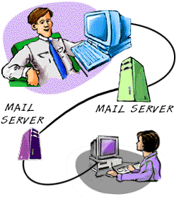

Dose of Reality:
Spoofed email
Notes:
That is why you see so many spoofed emails everyday.
[click]
Don’t be so excited if you receive an email from the former US president, Barack Obama , asking you to be his advisor.
You know it is fake.

Slide 55


Notes:
In addition to phishing emails, you may also receive anonymous email.
Now you know the root cause for it: there is no user authentication in SMTP.

Slide 56
POP3
Joe’s Mail Server
(TCP: 110)
Joe’s Local Host
user username
POP
Server
POP
client
+OK Password required.
pass password
TCP
+OK logged in.
IP
retrieve emails
QUIT
+OK Bye-bye.
user credentials are not protected.
Notes:
Next, let’s take a look at how POP3 works. Note that a POP3 server listens on TCP port 110.
So user name and password is transmitted in clear text.
It means someone else can intercept your authentication credentials if not protected.
So you must make sure your password is protected when transmitted over the network, for example, using SSL.

Slide 57
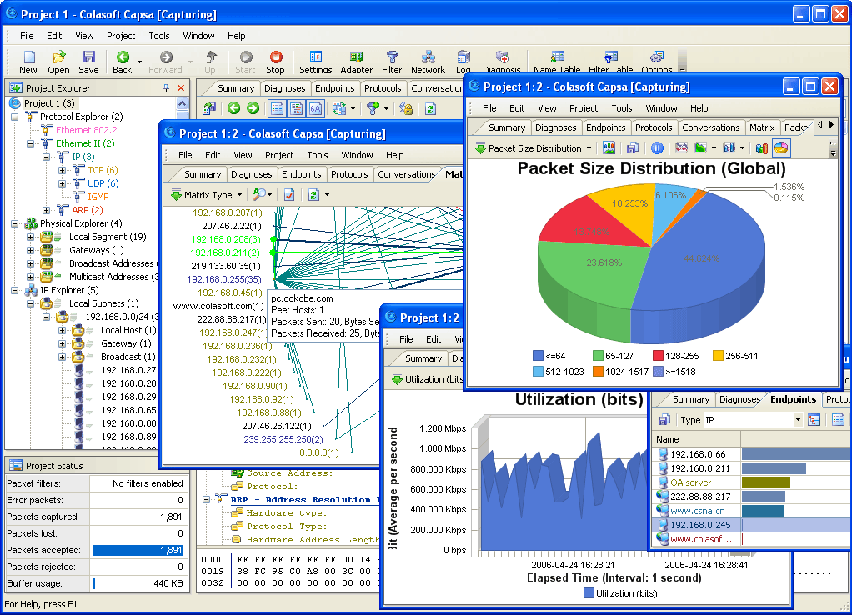
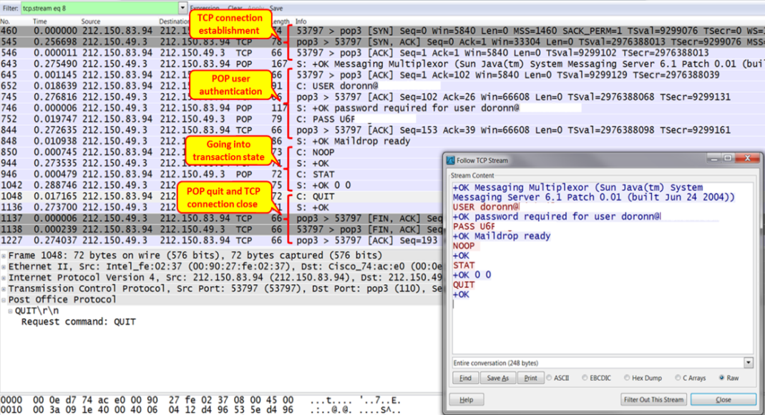
Protocol Analysis
[1] Wireshark for analyzing issues and malicious emails in POP, IMAP, and SMTP
https://hub.packtpub.com/wireshark-analyze-malicious-emails-in-pop-imap-smtp/
Notes:
This is an example of using Wireshark to capture and analyze POP network traffic. It can be observed that we are able to parse out the usrename and password from the captured network traffic.
Please note that when the POP3 protocol uses SSL/TLS for encryption, the payload details are not visible. .

Slide 58
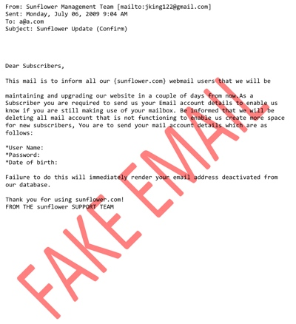
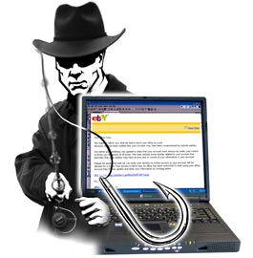

Dose of Reality:
Notes:
One reality we are facing today is “You receive a lot of fake emails every day”.

Slide 59

Email Forensics
Notes:
Therefore, another important topic in network forensics is email forensics.

Slide 60
Email Forensics
Email, one of the most popular network application, has become a primary means of communication.
However,
Email can easily be forged.
Email can be abused
Phishing/Spam
Threatening email
….
Notes:
Email, one of the most popular network application, has become a primary means of communication.
However, Email can easily be forged.
Also, email can be abused, for example,
Phishing/Spam
Threatening email

Slide 61

Phishing
[1] Know your Enemy: Phishing - Behind the Scenes of Phishing Attacks. http://www.honeynet.org/papers/phishing/
Notes:
Next, let us take a look at phishing in particular.

Slide 62
Phishing
Phishing is a method of attempting to spoof an identity of a trusted source, through email, etc. The objective of the phisher, i.e. the attacker, is to lure a victim into visiting a phishing server, i.e. a bogus server imitating as a trusted server, and fraudulently acquire sensitive personal information, such as username/passwords, from the victim.
Notes:
Phishing is a method of attempting to spoof an identity of a trusted source, through email, etc. The objective of the phisher, i.e. the attacker, is to lure a victim into visiting a phishing server, i.e. a bogus server imitating as a trusted server, and fraudulently acquire sensitive personal information, such as username/passwords, from the victim.

Slide 63
Phishing (cont’d)
Traditional phishing attacks involves mass emailing to a large number of users, and is so called “fishing” because of the low probability that the user will actually become a victim.
Latest studies show that phishing becomes more personal to increase the chances of trapping the victim, known as Spear phishing or Personal phishing. It involves acquisition of target's personal information to lure more sensitive information from the target.
- For example, a person's name, email address, phone number or address could be easily acquired and inclusion of these information in the phishing email will make the email looks much more authentic.
Notes:
There are two main types of phishing: Traditional phishing and Spear phishing.
Traditional phishing attacks involves mass emailing to a large number of users, and is so called “fishing” because of the low probability that the user will actually become a victim. Spammers will try to impersonate a trusted brand or contact, for example, someone from your financial institution or a potential employer. The goal is to get you to select a link, open an attachment, or provide personal or financial information.
Spear phishing, also known as Personal phishing, is a variation of phishing where scammers target a specific individual. It involves acquisition of target's personal information to lure more sensitive information from the target. In other words, the scammer already knows something about the victim, so it is more dangerous.

Slide 64
Phishing (cont’d)
"Phishing costs banks, online merchants and credit card companies an estimated $350 million to $500 million per year in losses or reimbursements to defrauded customers." "Moreover, these attacks are expensive; Gartner Inc. estimates that phishing schemes alone have cost banks $1.3 billion."
Furthermore, the long term side effects of phishing is loss of trust, and a severe impact of the brand and reputation of the enterprise businesses.
Identity theft costs on average $40,000 to $92,000 per incident, and it takes a long time to repair bad credits.
- Today, most financial institutions provide electronic banking services over the Internet, because it helps to significantly lower the production costs. Loss of trust is one of the biggest factors that turn customers away from using the electronic banking/commerce services.
Notes:
Phishing attacks, which attempt to persuade unsuspecting users to disclose confidential information or click links which can install malware, are a major problem. The phishing problem is even getting worse now.
Phishing costs banks, online merchants and credit card companies an estimated $350 million to $500 million per year in losses or reimbursements to defrauded customers.

Slide 65

Notes:
So we really want to find out the bad guy behind it.

Slide 66





Real world example
My account is emptied! Someone hacked into my online banking account!
Notes:
Next, let’s take a real world example to see how we can some computer network techniques to catch the bad guy.
Suppose you as a customer support of RBC, receive a call from one customer, complaining that his account is emptied. Someone hacked into his online banking account! This is a serious issue, which may lead to the public's trust declining in your online banking system.
[click]
So you want to help out by investigating the incident to find out the reason (most likely, phishing attack) and
[click]
catch the bad guy, though it is not the fault on your side since you know your online shopping system is secure.

Slide 67
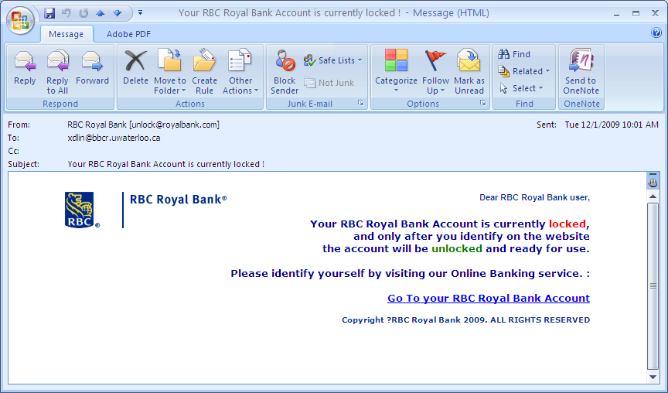
Real world example (cont’d)
Notes:
The customer told you that he received an "Your RBC online banking account is currently locked" email from RBC, which asks the customer to take an immediate action in order to unlock it. The customer followed the instructions from the email and clicked on a link embedded in the message to identify himself to the online system. But, his account is emptied now.
You know the customer has been attacked by a phishing email.
So you asked the customer to forward you the email.

Slide 68
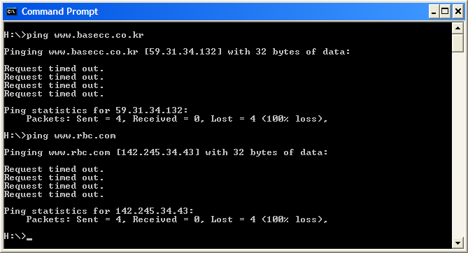


Real world example (cont’d)
http://www.basecc.co.kr/js/a.html
Contact the bad guy's ISP and obtain his contact data
Notes:
You check the email, which contains a web link.
When you hover over the URL and check the link, pointing to a strange website www.basecc.co.kr.
For sure, the link embedded in the message is not the RBC web link. If you ping two web links, the IP addresses are very different.
It conformed that it is a phishing attack.
[click]
Then, you find out the ISP based on the IP address used by the phishing web site. Afterwards, you can contact the bad guy's ISP and obtain his contact data.
[click]
Finally, you can contact the local law enforcement to have the bad guy arrested.

Slide 69
Email Investigations
Is this email authentic or spam? or find out who sent you that email
Email evidence:
The header of the email as well as the context
Writing style of the sender
Logs of the email server
Notes:
Besides checking if this email authentic or spam, sometimes you may also want to find out who sent you that email.
The evidence we can check include
The header of the email as well as the context
Writing style of the sender
Logs of the email server

Slide 70
Techniques
Ping/tracert
Verification of IP addresses:
Regional Internet Registry
APNIC (Asia Pacific Network Information Centre).
ARIN (American Registry of Internet Numbers).
LACNIC Latin American and Caribbean IP address Regional Registry.
RIPE NCC (Réseau IP Européens Network Coordination Centre).
Whois, for example, www.samspade.org
Notes:
There are different techniques for Email Investigations. For example, you can use Ping or tracert to check a suspicious IP address.
Also, you can find out the registration data for domain names used by the suspect. As a result, you are able to catch the bad guy.

Slide 71
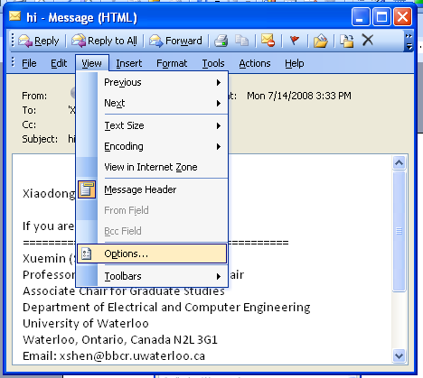

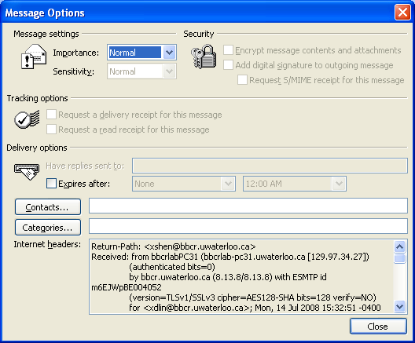

Email Tracing Examples
Forged IP
Notes:
Next, let us take a look at email tracing example, particularly, we check the email header.
When you receive an email, how can you that the email is indeed from the claimed sender.
For example, I receive an email from my former supervisor. Is the email authentic or indeed from him?
[click]
So I can check the email header, and take a look at the IP address of the computer that my supervisor used to send his email. I recognize this is the IP address he usually uses.
[click]
But this approach has a flaw, not perfect. Because IP address can be easily spoofed.

Slide 72

Tracing people online is very challenging
Notes:
In reality, tracing people online is very challenging.

Slide 73
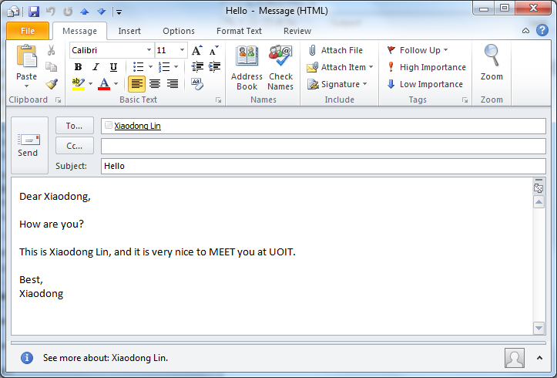


Authorship identification via Data mining
writing style features
Who’s behind anonymous email?
[1] F. Iqbal, R. Hadjidj, B. C.M. Fung, M. Debbabi. A novel approach of mining write-prints for authorship attribution in e-mail forensics. digital investigation 5 ( 2008 ) S42 – S51
Notes:
However, what a person did online may reveal his or her identity.
For example, we can take a look at the writing style of an email to figure out the authorship.
Of course, we talk about some ML algorithms to analyze the writing style.
As a result, you may know who sends you the anonymous email.

Slide 74






Anti-Forensics:
Notes:
Of course, the criminal may also know the danger of being caught because of his or her writing style. So he or she can try to conceal it. So you know we are talking about Anti-Forensics.
Actually, it happens in real word.
The criminals know it is very easy to get caught if he or she sends a handwriting letter to other people. This is because every person has their own unique style of handwriting. Therefore, it is very common that
criminals write their ransom letters with letters cut from newspaper or magazines.

Slide 75


Anti-Forensics (cont’d)
Notes:
Why not simply print out the ransom letter?
It is a bad idea since your printer also leave unique traces, which could be traced back to you.
Therefore, it is very common that criminals write their ransom letters with letters cut from newspaper or magazines.

Slide 76


Anti-Forensics (cont’d)
Notes:
Similarly, the criminals can prevent themselves from be identified by copying and pasting sentences from the Internet to compose an email, instead of writing the email by himself or herself.

Slide 77
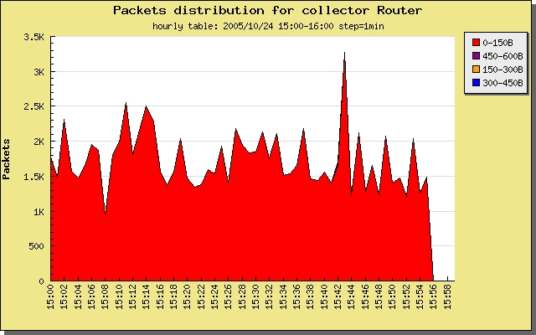
Abnormal Network Traffic Analysis
Notes:
Next, we look at abnormal Network Traffic Analysis, which is a classic security technique.

Slide 78

Intrusion Detection
Defined by International Computer Security Association (ICSA) as:
The detection of intrusions or intrusions attempts either manually or via software expert systems that operate on logs or other information available from the system or the network including network traffic.
An intrusion is a deliberate, unauthorized attempt to access or manipulate information or system and to render them unreliable or unusable. It can result in abnormal changes in network traffic behavior.
When suspicious activity is from your internal network it can also be classified as misuse.
Notes:
SO we are talking about Intrusion Détection technique.
An intrusion is a deliberate, unauthorized attempt to access or manipulate information or system and to render them unreliable or unusable. It can result in abnormal changes in network traffic behavior.
So we are able to detect the intrusion based on the abnormal changes in network traffic behavior.

Slide 79
Dose of Reality:
Analyzing the network traffic could be able to identify attacks/security issues, for example, DoS, botnet, game bots, etc.
[1] K.-T. Chen, J.-W. Jiang, P. Huang, H.-H. Chu, C.-L. Lei, and W.-C. Chen. Identifying MMORPG Bots: A Traffic Analysis Approach. EURASIP Journal on Advances in Signal Processing, 2009
Notes:
Analyzing the network traffic could be able to identify attacks/security issues, for example, DoS, botnet, game bots, etc.

Slide 80
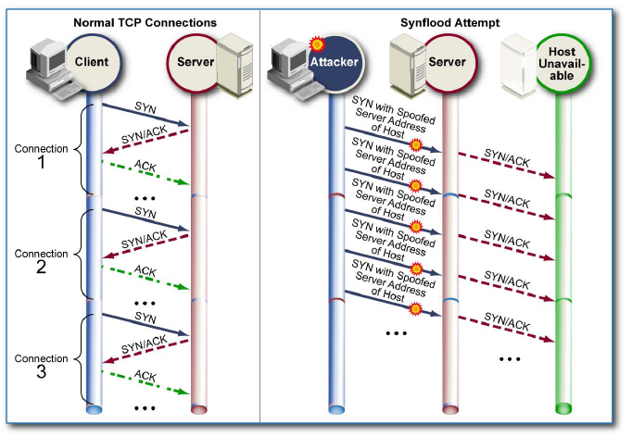
Syn floods
Three-way TCP
connection handshake
Notes:
Next, we will use a famous DoS attack (Syn flooding attack) as an example.
First, let us recap how Three-way TCP connection handshake works.
This is illustrated in the figure on the left. The client system initiates the request for a TCP connection by sending a SYN packet to the server. This identifies the client’s address and port number, and supplies an initial sequence number. The server records all the details about this request in a table of known TCP connections. It then responds to the client with a SYN-ACK packet. Once the client receives this it sends an ACK packet to the server, and marks the connection as established.
However, this Three-way TCP connection handshake can be abused by an attacker.
The attacker generates a large number of SYN connection request packets with forged source addresses in a short time. For each of these the server records the details of the TCP connection request, and sends the SYN-ACK packet to the claimed source address, as shown in the Figure on the right. The server will then send the SYN-ACK packet a number of times. Unfortunately, the client’s ACK packets will never come to the server, leaving the server with a large number of half open connections. Eventually, any future requests, including legitimate requests from other users, are rejected. It becomes a DoS attack.

Slide 81

SYN floods (cont’d)
SYN flood
Sends a flood of TCP/SYN packets, with a forged sender IP address
Each is handled like a connection request
Cause the server to spawn a half-open connection
The server sends back a TCP/SYN-ACK packet, and waiting for a TCP/ACK packet
Unfortunately, the response never comes
Notes:
In summary, In a SYN flood attack,
the attacker
Sends a flood of TCP/SYN packets, with a forged sender IP address
Each is handled like a connection request, and causes the server to create a half-open connection
The server sends back a TCP/SYN-ACK packet, and waiting for a TCP/ACK packet
Unfortunately, the response never comes

Slide 82


How can we detect possible SYN flood attacks?
Notes:
Next, let us have a discussion on how to detect SYN flood attacks. Remember you now already know how a syn flooding attack looks like. In other words, you know its behavior.

Slide 83
SYN Flood Attack Detection
We observe a target with an abnormally high volume of half-open connections. Each of them is allocated with resources from the server. since these resources are finite, a large number of connections will make the port on the target unusable.
The most likely reason for these activities are the presence of DoS/DDoS attacks or network scans.
Notes:
It is obvious that when a server is under SYN flooding attack, we will observe the target with an abnormally high volume of half-open connections. Each of them is allocated with resources from the server. since these resources are finite, a large number of connections will make the port on the target unusable.

Slide 84

We go BEYOND network traffic to investigate what happened in the network
Notes:
We go BEYOND network traffic to investigate what happened in the network.

Slide 85
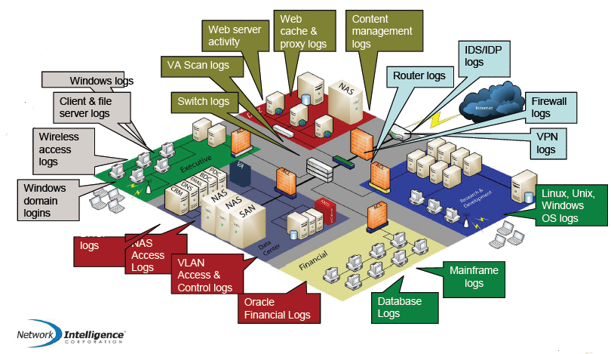
Dose of Reality:
* courtesy of Network Intelligence, a leader in the security information and event management market, acquired by EMC Corporation .
Notes:
Today’s computer systems and applications generate logs when something happens or needing for attention (e.g., a computer system being configured to record user login attempts.). These logs can provide solid forensic evidence to reveal a user’s misbehaving activities and discover how, when and where of an incident and help identify cybercriminals.

Slide 86
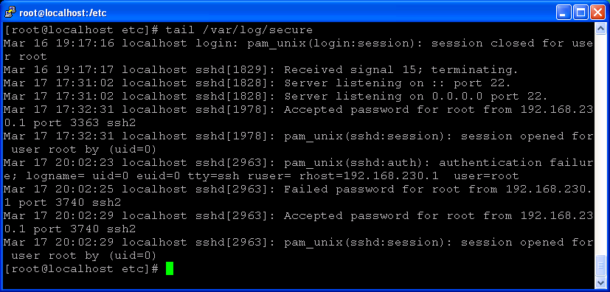

Dose of Reality: (cont’d)
Brute force password guess attack?
Notes:
For example, we can configure a Linux system to record user login attempts.
In the example here, you can observe that someone tried to log into the root user account on the system remotely from an IP address 192.168.230.1, but failed.
If we find many failed login attempts against a user account in a short period, it is highly like that the system is under
password guess attack.

Slide 87
Challenges
Security event storm
What’s really happening in my network?
The raw network security data doesn't tell you too much, and sometimes can be very hard to understand
The syntax and semantics of data within log messages are usually application or vendor-specific.
You might need to develop log parser for each application/device.
Log message format or content may not always be fully documented.
Each raw alerts/events from various security devices may only tell you a partial or duplicate story about one attack
Notes:
System logs from computer systems and applications are very useful to help us investigate a network incident.
Unfortunately, today, enterprise environments have become more complex with many computer systems and networks of different types. Also, they secure themselves with a variety of third party security technologies from a number of vendors distributed located in the different locations of the enterprise network. The complex environments pose challenges to log analysis.
First, computer devices in an enterprise environments provide an overwhelming amount of information. It becomes infeasible for human review. It is also called event storm.
Second, the raw network security data doesn't tell you too much, and sometimes can be very hard to understand. Each raw alerts/events from various security devices may only tell you a partial or even duplicate story about one attack

Slide 88
Challenges (cont’d)
Lack of event interpretation of the security events. For example,
some devices use specialized codes or signatures to identify what “type” of alert or error is being generated. For instance, in Windows NT, the “Event Viewer” has codes like 529, which represents login failure because of unknown user name or incorrect password
the security administrator basically has historic information on their managed networks, for example, a host with IP address of 1.1.1.1 is the corporate web server, Very Important, but, ……
Lack of real-time response capability
Too many alerts, but limited security response resources.
Notes:
Further, log messages comes in different formats, and the format of logs from some devices can be
also custom defined. And to make matters worse, some devices use specialized codes
or signatures to identify what “type” of alert or error is being generated. For instance, in Windows NT, the “Event Viewer” has codes like 529, which represents login
failure because of unknown user name or incorrect password. As such, sometimes log messages are very hard to understand.
Also, lack of real-time response capability. Too many alerts, but limited security response resources.

Slide 89
Challenges (cont’d)
So many regulatory and compliance standards
regulatory standards:
HIPAA (Health Insurance Portability & Accountability Act),
SOX (Sarbanes-Oxley),
North American Electric Reliability Council (NERC) Critical Infrastructure Protection (CIP) Reliability Standards,
Federal Information Security Management Act (FISMA), etc
or industry standards:
PCI (Payment Card Industry Compliance) DSS,
ISO 27001/2,
NIST 800-53,
Control Objectives for Information and related Technology (COBIT), etc.
You as well as organizations are responsible for regulatory violation.
For example, for HIPAA noncompliance, individual violation: Fine up to $1.5 million per calendar year and possible jail time
It is important to know your security posture.
Notes:
There are many regulatory and compliance standards, which governments and organizations must follow. Otherwise, they will be punished for violating these regulations. For example, the penalties for HIPAA noncompliance are based on the perceived level of negligence and can range from $100 to $50,000 per individual violation, with a max penalty of $1.5 million per calendar year for violations. Additionally, violations can also result in jail time for the individuals responsible.
For this reason, businesses and organizations in the private and public sector must know their security posture.

Slide 90



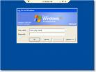
Security Information and Event Management (SIEM)
IDS alerts
Anti-virus alerts
Firewall logs
……
Authentication server logs
* Security Event Management (SEM) or Security Information Management (SIM) or Enterprise Security Management (ESM)
Notes:
This is where Security Information and Event Management (SIEM) comes into play.

Slide 91


















OPERATIONS INTEGRATION
VISUALIZATION / ADMINISTRATION
Security alerts
Reports
Network / security operations
Help desk ticketing
Visualization
REAL-TIME ANALYSIS / RESPONSE
LONG-TERM STORAGE / AUDIT / INVESTIGATION
Policies / compliance rules
Signatures / attack patterns
raw log
101010001011100110
COLLECTION / AGGREGATION / CORRELATION
RESPONSE
Central / master collector
RESPONSE
Distributed collectors
INPUTS
Agent
Logging
Agent
Logging
Agent
Logging
Agent
Logging
Identity Management
System Management
Perimeter Controls
IDS / Response
Access control
Directories
Provisioning
Host & DB configuration
Patch management
Vulnerability management
Routers
Firewalls
Content scanners
Network IDS
Network IPS
Other sensors
System architecture of SIEM
Notes:
A typical system architecture of SIEM has multiple layers.
As you can see, the lowest tier (layer) of this architecture is mainly concerned with the retrieval of system logs from computer systems and applications, either configuring the computer systems and applications, for example, sending logs via Syslog, or developing some software or agents to read log and send logs via Syslog.
The second layer of this architecture is used to collect log data and store them into some centralized locations. Also, it will covert them into a standard format.
The third layer of this architecture is the tier in which the analysis runs. In other words, this is the key of SIEM, which is used to identify the security issues, and develop and maintain security monitoring processes for the systems in an organization, in a real-time manner.
The topmost layer of this architecture provides presentation services, that is presentation, of findings (e.g., security alerts) to the system administrators through GUI, for example, Web interface.

Slide 92
Solutions and Technology
How SIEM Works
Collect
Inputs from target sources
Agent and agentless methods
Aggregate
Bring all the information to a central point
Normalize
Translate disparate syntax into a standardized one
Correlate
If A and B then C
Report
State of health
Policy conformance
Archive
Collect
Aggregate
Normalize
Correlate
Report
Archive
Notes:
How does SIEM Work?
This is a typical workflow for Security Information and Event Management (SIEM).

Slide 93
Emerging Trends
Early SIEMs focused on gathering logs from the perimeter security devices
Firewalls, routers
Evolution is toward a more comprehensive integration
Take in more input for greater vision
Monitoring activity both inside the organization as well as on the perimeter
Additional intelligence can lead to more precise correlation
Notes:
SIEM technology is evolving. Early SIEMs focused on gathering logs from security devices and applications, for example, Firewalls. It is now evolving toward a more comprehensive integration with other security solutions.

Slide 94

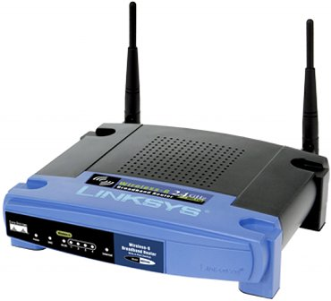
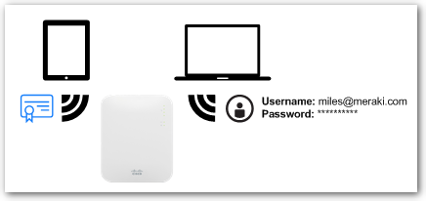

Emerging Trends (cont’d)
Monitoring for Abuse
As the focus is turned inward (insider threat)
User behavior can be captured
Links back to Identity Management synch with SIEM
Now I know who did it?
Notes:
For example, SIEM starts to intergrade with Identity Management.
As such, user behavior can be captured.
It means the focus is turned inward (insider threat). An insider threat is a security risk to an organization that comes from within the business itself.
It is the greatest threat to any company today.
For example, let us take a look at a big enterprise wireless network.
In other words, a user can connect to the enterprise network when moving around. So it is very hard to trace the user. However, the user has to be authenticated, for example, using his or her certificate or domain user account credentials. As such, we know which user is using which IP address. Therefore, all the network behavior from that IP address, which is visible from a network aspect, is associated to a user.

Slide 95
Emerging Trends (cont’d)
A community approach?
OSSIM^{[1]} – Open Source Security Information Management, an Open Source SIM Project
Ties together open source security management tools
Build collaborative intelligence via data sharing amongst enterprises
Attacker profiles
Risk metrics
[1] http://www.ossim.net/
Notes:
There are many SIEM products available today.
OSSIM is an open source security event management system, providing security analysts and administrators a view of all the security-related
aspects of their system.

Slide 96
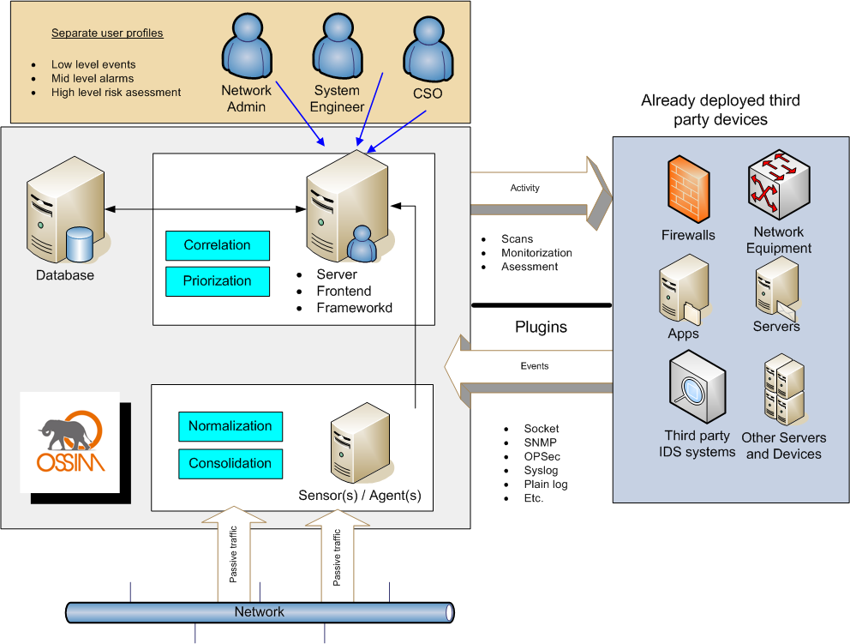
Open source on the move
OSSIM aims to unify network monitoring, security, correlation and qualification in one single tool. Integrating Snort, Acid/Base, MRTG, NTOP, Nagios, NMAP, Nessus and RRDTool OSSIM wants the user to have full control over every network or security aspect.
[1] http://www.ossim.net/
[2] Another open source SIM tool is OpenSIMS, http://opensims.sourceforge.net/.
Notes:
OSSIM aims to unify network monitoring, security, correlation and qualification in one single tool. Integrating many security tools including Snort, NMAP, Nessus, etc., OSSIM wants the user to have full control over every network or security aspect.

Slide 97
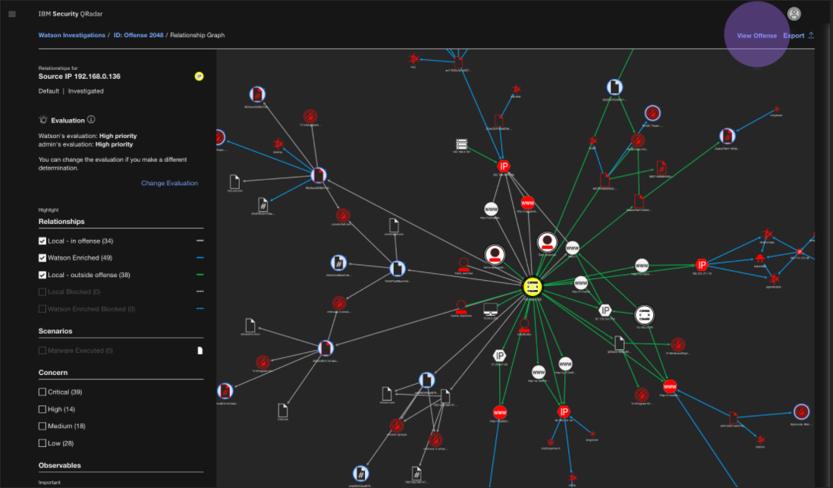




Notes:
Also, there are many commercial SIEM products available today. For example, ArcSight Enterprise Security Manager (ESM) from Micro Focus, Security QRadar from IBM.

Slide 98

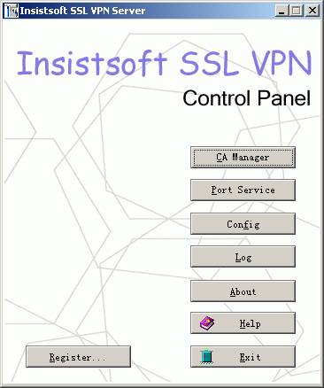




Syslog messages
snort
Syslog collector
VPN server
APACHE Web Server
10.0.0.1
xyz is Joe@Reynolds2210
xyz is using ip blah now
Joe@Reynolds2210 is DoS attacking my Web server
xyz is DoS attacking 10.0.0.1 now
ip blah is DoS attacking 10.0.0.1 now
Notes:
Let us look at a case study we did before. Suppose that the VPN server records a login event for any given user along with a location and timestamp and forwards it to the centralized log server.
Around the same time as the login event, a DoS attack was detected by Snort, originating from ip address blah against a company computer of IP address of 10.0.0.1.
Based on VPN server logs, you find out a user with UID xyz is using ip address blah. Through event correlation, we now know that the user with UID
xyz is DoS attacking a computer of IP address of 10.0.0.1.
Further, we search asset database and find out that IP address of 10.0.0.1 is assigned to the company web server, which is an important server for the company.
Also, we find the full name of the user with UID xyz by querying Active Directory. Assume that user xyz’s full name is Joe at Reynolds 2210. Finally, we can conclude that user Joe is DoS attacking the company web server.
The conclusion is very helpful in terms of two things compared to the raw log data collected. First, we know who the attacker is. Second, we know this is a critical incident, and therefore it must be given a high priority.

Slide 99

Syslog messages
snort
Syslog collector
VPN server
APACHE Web Server
10.0.0.1
Joe@UA2220 is DoS attacking my Web server
Notes:
It is great that we can conclude that user Joe is DoS attacking the company web server. It makes more sense from a system admin point of view.

Slide 100
References
“TCP/IP Illustrated, Volume 1 The Protocols “
by W. Richard Stevens
“Internet Working with TCP/IP Volume 1: Principles, Protocols, and Architecture ”
by Douglas E. Comer
Official TCP/IP Port Assignments. http://www.iana.org/assignments/port-numbers
Trends in Security Management. CA. http://www.fspgroup.ca/docs/FSP20061020_01.ppt
http://www.jessland.net/JISK/IDS_IPS/Log_Analysis/Tools.php

